Slide 1
Machine Learning
Evaluation Metrics
Classification
Confusion Matrix, Accuracy, Precision, Recall, F1

Slide 2
Outline
Classification Accuracy (0/1 Loss)
TP, TN, FP and FN
Confusion Matrix
Sensitivity, Specificity,
F1-Score and Matthew’s Correlation Coefficient
Multi-class Classification, Evaluation, Micro, Macro Averaging

Slide 3
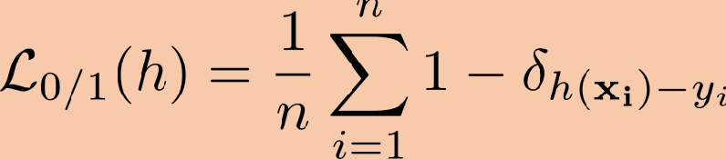
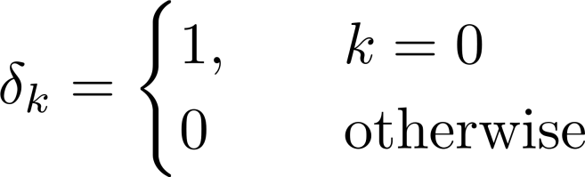
Evaluation of Classification Performance
Classification Accuracy, Misclassification Rate (0/1 Loss):
For each test-point, the loss is either 0 or 1; whether the prediction is correct or incorrect.
Averaged over n data-points, this loss is a ‘Misclassification Rate’.
Interpretation:
Misclassification Rate: Estimate of the probability that a point is incorrectly classified.
Accuracy = 1- Misclassification rate
Issue:
- Not meaningful when the classes are imbalanced or skewed.

Slide 4
Evaluation of Classification Performance
Classification Accuracy (0/1 Loss):
Example:
Predict if a bowler will not bowl a no-ball?
Assuming 15 no-balls in an inning, a model that says ‘Yes’ all the time will have
95% accuracy.
Using accuracy as performance metric, we can say that a model is very accurate, but it is not useful or valuable in fact.
Why?
Total points: 315 (assuming other balls are legal ☺)
No-ball label: Class 0 (4.76% are from this class)
Not a no-ball label: Class 1 (95.24% are from this class)
Imbalanced Classes

Slide 5
Evaluation of Classification Performance
TP, TN, FP and FN:
- Consider a binary classification problem.

Slide 6
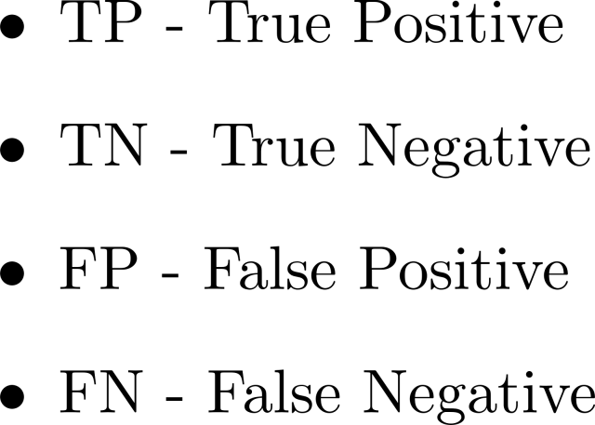
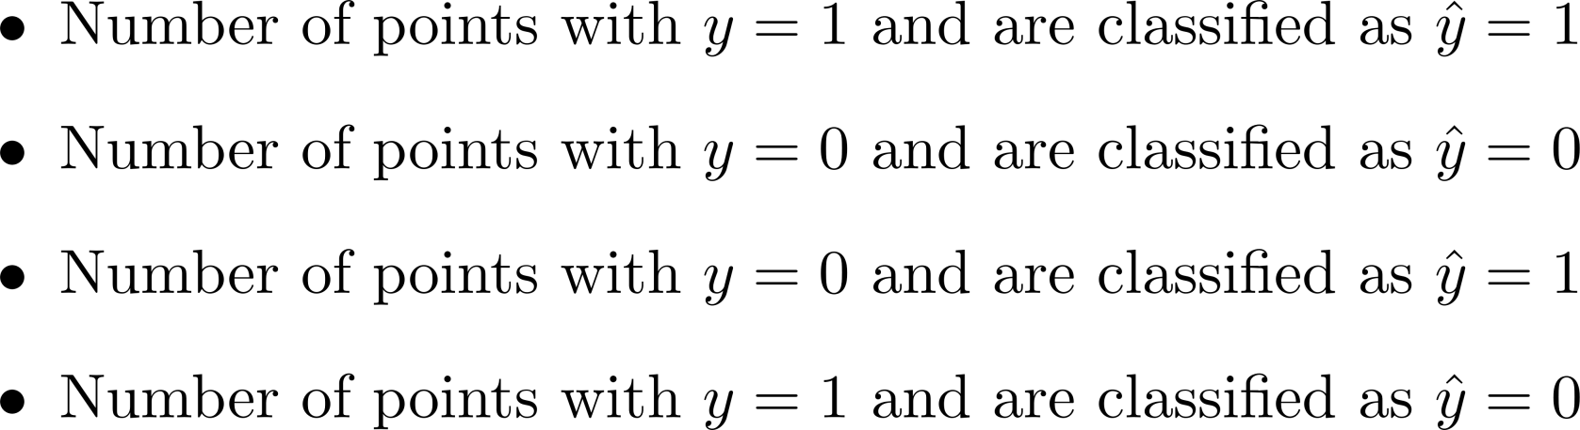
Evaluation of Classification Performance
TP, TN, FP and FN:

Slide 7
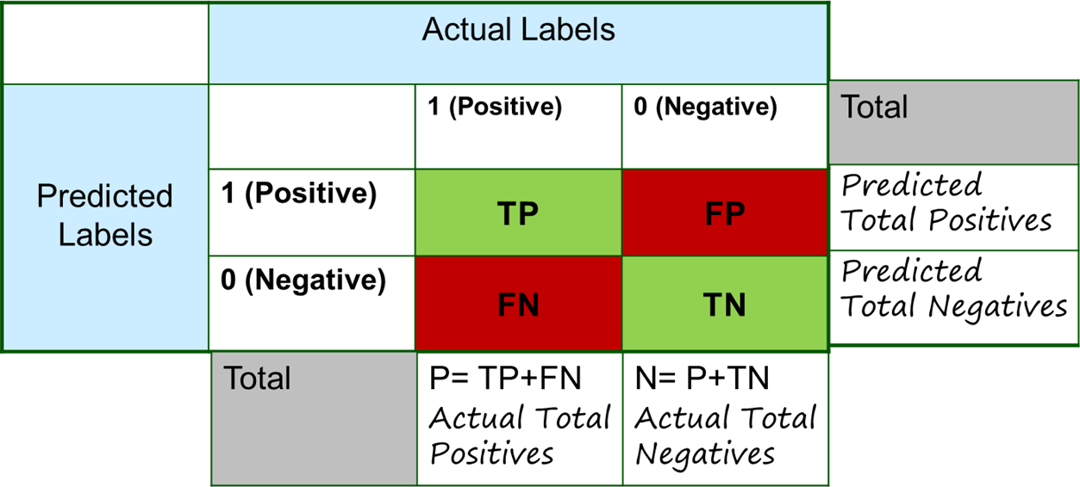
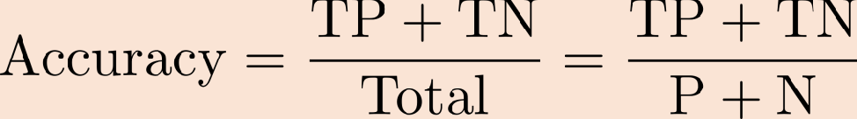
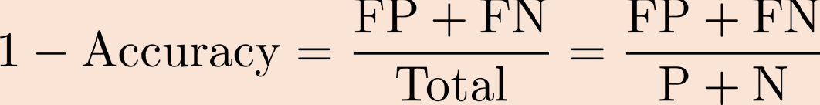
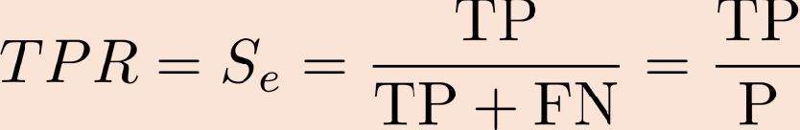
Confusion Matrix:
Metrics using Confusion Matrix:
- Accuracy: Overall, how frequently is the classifier correct?
- Misclassification or Error Rate: Overall, how frequently is it wrong?
- Sensitivity or Recall or True Positive Rate (TPR): How often does it predict Positive when it is actually Positive?

Slide 8

Accuracy
Accuracy is the measure of correct predictions. In terms of FP, TP, TN, and FN, accuracy is

Slide 9

Precision
Precision is how many images predicted as positive are positive.

Slide 10

Recall
The recall is the ratio of images correctly identified as positive.

Slide 11
F1 Score
F measure:

Slide 13
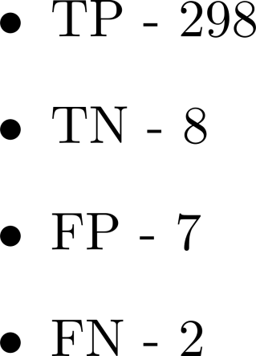
Evaluation of Classification Performance
TP, TN, FP and FN:
Example:
Predict if a bowler will not bowl a no-ball?
15 no-balls in an inning (Total balls: 315)
Bowl no-ball (Class 0), Bowl regular ball (Class 1)
Model(*) predicted 10 no-balls (8 correct predictions, 2 incorrect)
* Assume you have a model that has been observing the bowlers for the last 15 years
and used these observations for learning.

Slide 14
Confusion Matrix:
Example:
Disease Detection :
Given pathology reports and scans, predict heart disease
Yes: 1, No: 0
Interpretation:
Out of 165 cases
Predicted: “Yes" 110 times, and “No" 55 times
In reality: “Yes" 105 times, and “No" 60 times
 | Actual Labels
Predicted Labels |  | 1 (Positive) | 0 (Negative) | Total
 | 1 (Positive) | TP = 100 | FP = 10 | 110
 | 0 (Negative) | FN = 5 | TN = 50 | 55
 | Total | P = 105 | N = 60

Slide 15
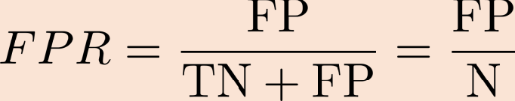
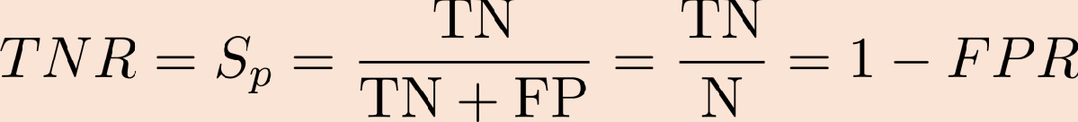
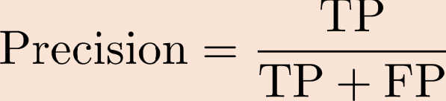
Confusion Matrix:
Metrics using Confusion Matrix:
- False Positive Rate: Actual Negative, how often does it predict Positive?
- Specificity or True Negative Rate (TNR): When it's actually Negative, how often does it
predict Negative?
- Precision: When it predicts Positive, how often is it Positive?

Slide 16
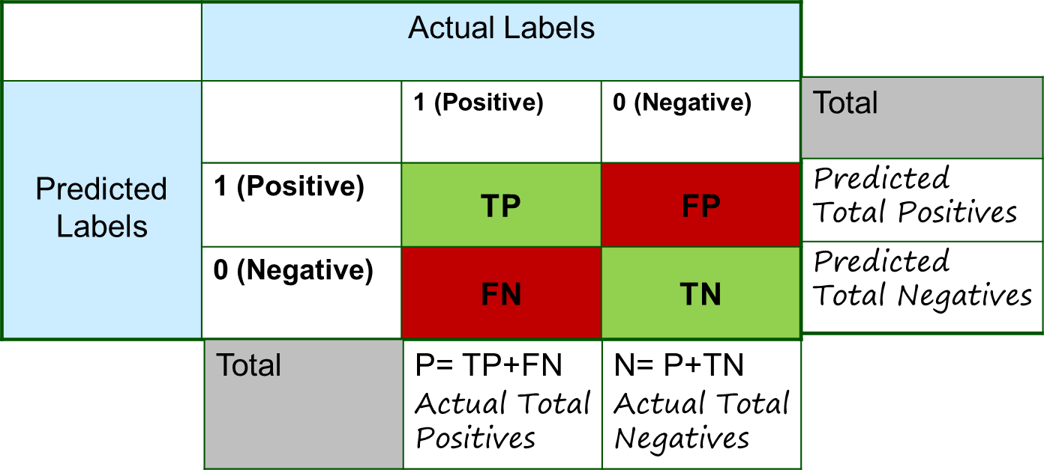
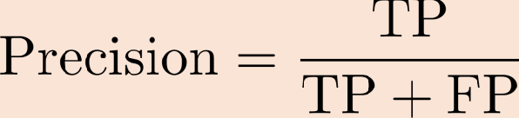
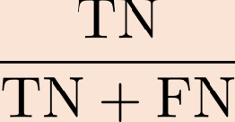
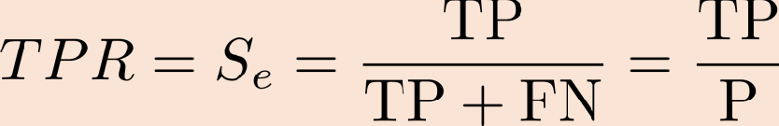
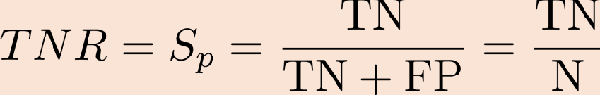
Evaluation of Classification Performance
Confusion Matrix Metrics:
Negative Predicted Value

Slide 17
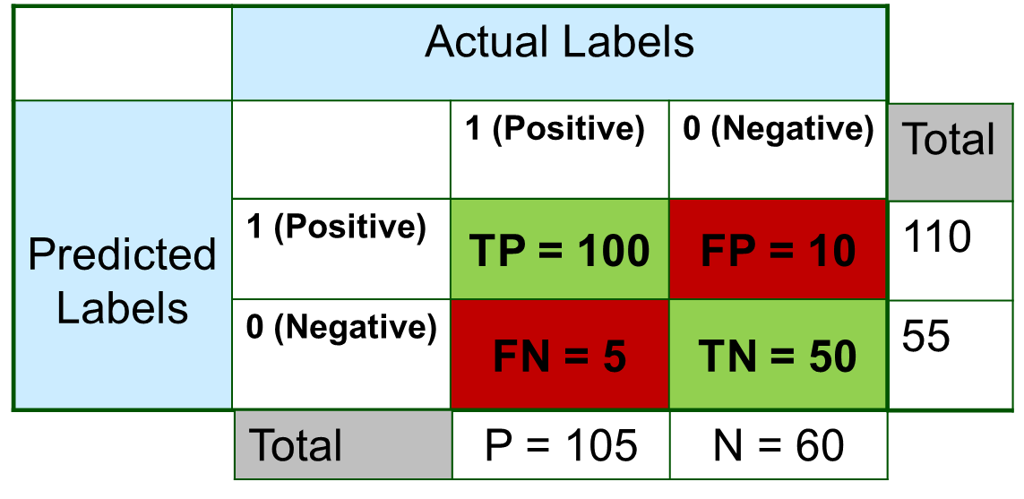
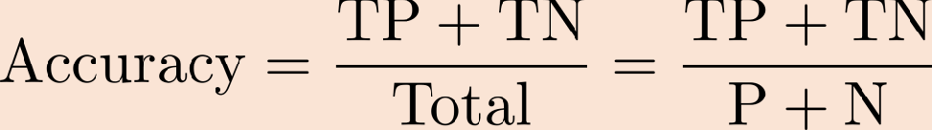
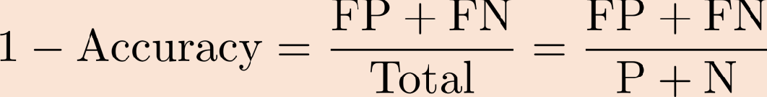
Confusion Matrix:
Metrics using Confusion Matrix (Example: Disease Prediction):
Accuracy: Disease/Healthy prediction accuracy
= (100+50)/165 = 0.91
Misclassification or Error Rate: Disease/Healthy prediction accuracy
= (10+5)/165 = 0.09
Sensitivity or Recall or True Positive Rate (TPR): When it's positive, how often does the model detected disease?
= 100/105 = 0.95

Slide 18

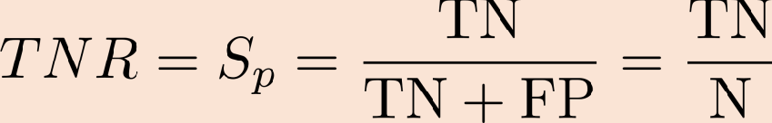
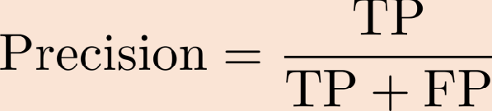
Confusion Matrix:
Metrics using Confusion Matrix (Example: Disease Prediction):
False Positive Rate: Actually heathy, how often does it predict yes?
= 10/60 = 0.17
Specificity or True Negative Rate (TNR): When it's actually health, how often does it predict healthy?
= 50/60 = 0.83
Precision: When it predicts disease, how often is it correct?
= 100/110 = 0.91

Slide 19
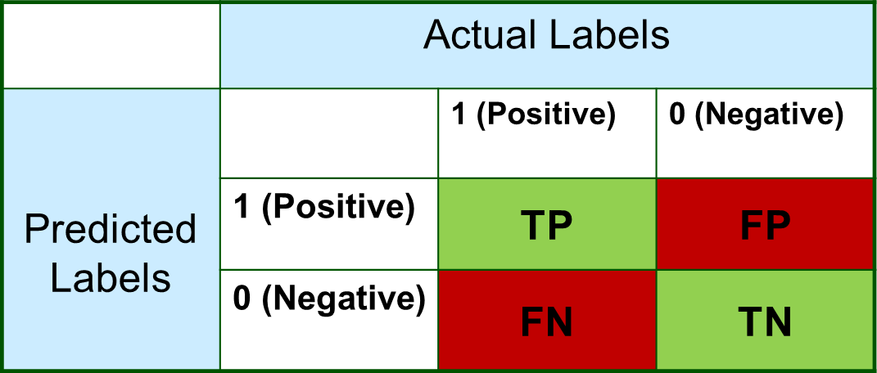
Confusion Matrix:
Metrics using Confusion Matrix:
When to use which?
- Disease Detection: We do not want FN
- Fraud Detection: We do not want FP

Slide 20
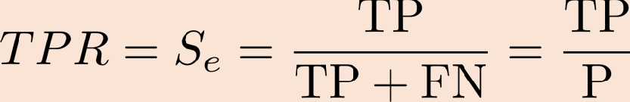
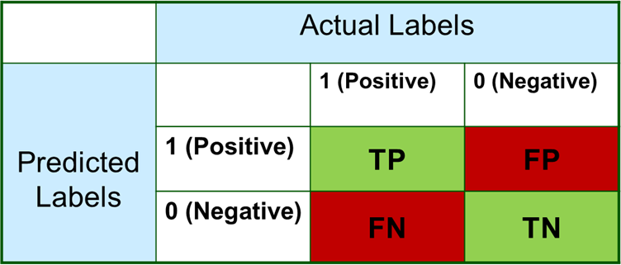
Confusion Matrix:
Precision and Sensitivity (Recall) Trade-off:
Sensitivity or Recall Precision
- Disease Detection:
Recall or Sensitivity (S_{e}); how good we are at detecting diseased people.
Precision: How many have been correctly diagnosed as unhealthy.
If we have diagnosed everyone unhealthy, S_{e}=1 (diagnose all unhealthy people correctly) but Precision may be low (because TN=0 that increases the value of FP).
We want high Precision and high S_{e} (=1, Ideally).
We should combine precision and sensitivity to evaluate the performance of classifier.
- F1-Score

Slide 21

Confusion Matrix:
Sensitivity and Specificity Trade-off:
Sensitivity or Recall Specificity
- Disease Detection:
S_{p} and S_{e}; how good we are at detecting healthy and diseased people, respectively.
If we have diagnosed everyone healthy, S_{p}=1 (diagnose all healthy people correctly) but
S_{e}=0 (diagnose all unhealthy people incorrectly)
Ideally: we want S_{p}= S_{e}= 1 (perfect sensitivity and specificity) but unrealistic.

Slide 22


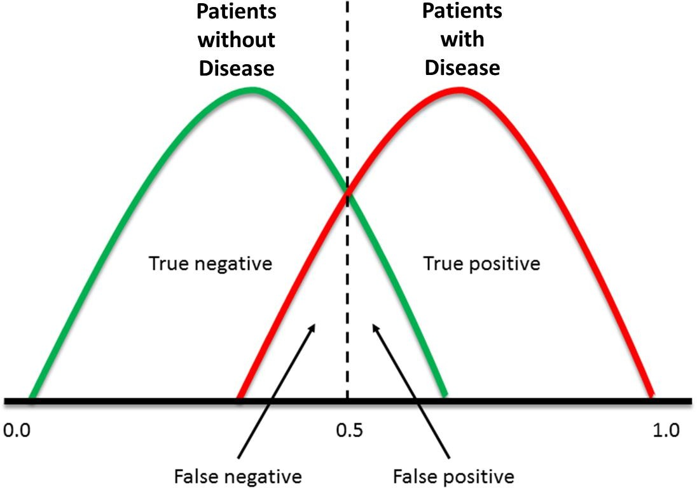
Confusion Matrix:
Sensitivity and Specificity Trade-off:
How optimal a pair of sensitivity, specificity values is?
- Is S_{p}= 0.8, S_{e}= 0.7 better than S_{p}= 0.7, S_{e}= 0.8?
Threshold
The answer depends on the application.
In disease diagnosis;
- happy to reduce S_{p} in order to increase S_{e}.
In other applications, we may have different requirements.
Trade-off is better explained by ROC curve and AUC.
S_{e}= 1 S_{p}= 1

Slide 23
Matthew’s Correlation Coefficient (MCC):
Precision, Recall and F1-score are asymmetric. Get a different result if the classes are switched.
Matthew’s correlation coefficient determines the correlation between true class and predicted
class. The higher the correlation between true and predicted values, the better the prediction.
Defined as
MCC=1 when FP = FN = 0 (Perfect classification)
MCC=-1 when TP = TN = 0 (Perfect misclassification)
MCC=0; Performance of classifier is not better than a random classifier (flip coin)
MCC is symmetric by design

Slide 24
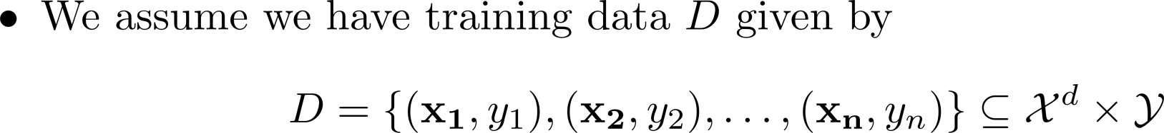
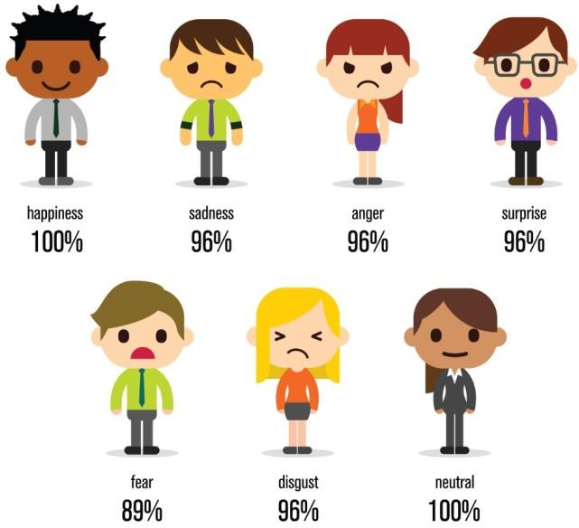

Multi-Class Classification
Formulation:
Examples:
Emotion Detection.
Vehicle Type, Make, model, color of the vehicle from the images streamed by safe city camera.
Speaker Identification from Speech Signal.
State (rest, ramp-up, normal, ramp-down) of the process machine in the plant.
Sentiment Analysis (Categories: Positive, Negative, Neutral), Text Analysis.
Take an image of the sky and determine the pollution level (healthy, moderate, hazard).
Record Home WiFi signals and identify the type of appliance being operated.

Slide 25
Multi-Class Classification
Implementation (Possible options using binary classifiers): Option 1: Build a one-vs-all (OvA) one-vs-rest (OvR) classifier:
Option 2: Build an all-vs-all classifier:
There can be other options…

Slide 26
Evaluation of Classification Performance
Multiclass Classification:
How do we define the measures for the evaluation of the performance of multi-class classifier?
Macro-averaging: We compute performance for each class and then average.
Micro-averaging: Compute confusion matrix after collecting decisions for all classes and then evaluate.

Slide 27






Multiclass Classification:
Confusion Matrix
Predict if a bowler will bowl a no-ball, wide bowl, regular bowl?
15 no-balls, 20 wide-balls in an inning (Total balls: 335)
Model Predictions:
Actual
Wide-ball Regular ball
No-ball
Precision
8 | 5 | 20
2 | 10 | 10
5 | 5 | 270
No-ball
Classifier Output
Wide-ball
Regular ball
Recall

Slide 28
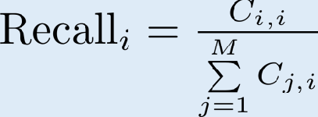
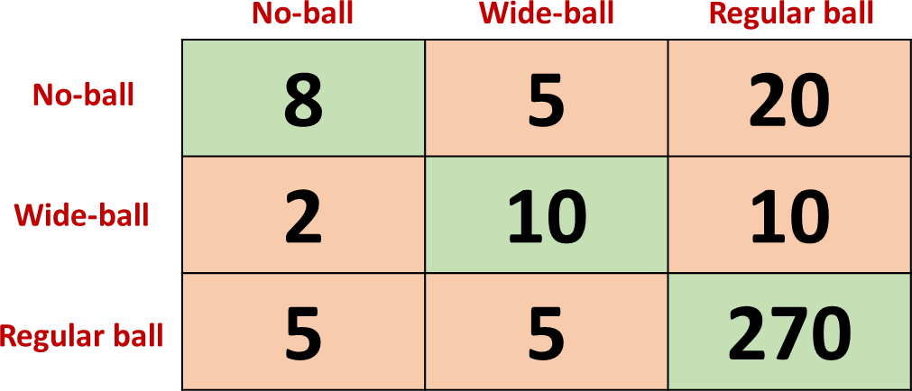
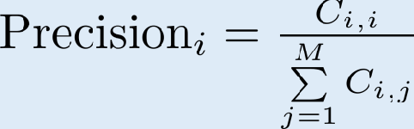
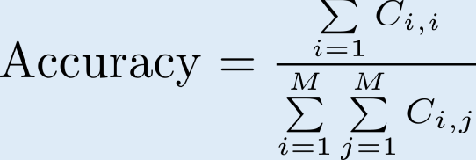
Multiclass Classification:
Confusion Matrix – Recall and Precision:
Recall
For i-th class, recall represents the fraction of data-points classified correctly, that is,
Precision
For i-th class, precision represents the fraction of data-points
predicted to be in class i are actually in the i-th class, that is,
Accuracy
Fraction of data points classified correctly, that is,

Slide 29




Multiclass Classification:
Confusion Matrix – Macro-Averaging:
- We compute performance for each class and then average.
Confusion Matrix – Each Class:
Actua_{N}l _{ot a}
Actual
Not
Actual
Regular Not Regular
No-ball
No-ball
Wide
Wide
8 | 25
7 | 295
10 | 12
10 | 303
270 | 10
30 | 25
No-ball
Classifier
Wide
Regular
Output
Not a no- ball
Recall
Not Wide
Not
Regular
Macro-average Recall:

Slide 30

Multiclass Classification:
True
False
Micro-average Recall:
Confusion Matrix – Micro-Averaging:
- Compute confusion matrix after collecting decisions for all classes and then evaluate.
288 | 47
47 | 623
True
False
Confusion Matrix – Each Class:
Actua_{N}l _{ot a}
Actual
Not
Actual
Regular Not Regular
No-ball
No-ball
Wide
Wide
8 | 25
7 | 295
10 | 12
10 | 303
270 | 10
30 | 25
No-ball
Classifier
Wide
Regular
Output
Not a no- ball
Not Wide
Not Regular

Slide 31
Multiclass Classification:
Micro-Averaging vs Macro Averaging:
Note Micro-average recall= Micro-average precision = F1 Score = Accuracy (computed from
confusion matrix)
Micro-average is termed as a global metric.
Consequently, it is not a good measure when classes are not balanced.
Macro-average is relatively a better as we can see a zoomed-in picture before averaging.
Note Macro-averaging does not take class imbalance into account.
Weighted-averaging; Similar to Macro averaging but takes a weighted mean instead where weight for each class is the total number of data-points of that class.
Weighted-average Recall:

